Slide 1
Vote By Mail
A Presentation and Information Session for Candidates
Wednesday, September 7, 2022

Slide 2
Why Explore Alternative Voting?
Council has the authority under MEA
Used by municipalities for many years
Voter engagement
Voter expectations
Accessibility

Slide 3
Why Vote By Mail?
Decentralized population in Guelph/Eramosa
Opportunities to partner with neighbouring municipalities
Previous experience with this voting method
Voter turnout

Slide 4
What is Vote By Mail?
Ballots mailed to electors within voting kits
Voters can vote anywhere, 24/7 during the voting period
Voters can mail their completed voting kit or drop it off to Ballot Return Stations
Central location for vote counting
Used as a voting method by 13.3% of municipalities in 2018 (internet voting used by 42.3%)

Slide 5
How to Vote by Mail (VBM)

Slide 7
The VBM Process
Voters’ List established through the Preliminary List of Electors (PLE) from MPAC
Voting kits are mailed to eligible voters on the List
Eligible voters who did not receive a kit can complete an application to amend the Voters’ List, have their name added and receive a kit

Slide 8
Key Dates for VBM
September 26, 2022 | Voting kits mailed by service provider
September 26 to September 30, 2022 | Voting kits received in mail by electors
October 3 to 24, 2022 | Daily processing of returned kits
October 13, 2022 | Last day to mail completed voting kits
October 24, 2022 | Voting Day – last day to drop off or obtain and complete a voting kit (by 8:00 p.m.)

Slide 9
Ballot Return Stations
Municipal Office 8348 Wellington Road 124 | Mon, Sep 26 to Thurs, Oct 20 (8:30am – 4:30pm) Fri, Oct 21 (8:30am – 7:00pm) Election Day – Mon, Oct 24 (8:30am – 8:00pm)
Marden Community Centre 7368 Wellington Road 30 | Wed. Oct 19 (4pm – 8pm) Sat, Oct 22 (10pm – 4pm)
Rockmosa Older Adult Centre 121 Rockmosa Drive, Rockwood | Tues. Oct 18 (4pm – 8pm) Sat, Oct 22 (10pm – 4pm)
Royal Distributing Athletic Performance Centre | Mon Oct 17, 2022 9am – 12pm (noon)
After hours drop box at Municipal Office | 24/7 until October 24, 2022 at 8:00 p.m.

Slide 10
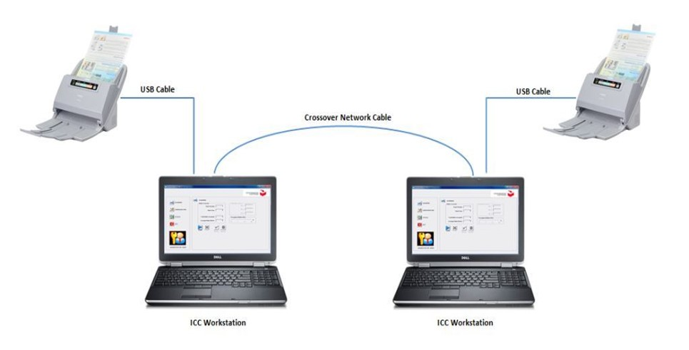
Tabulator Count

Slide 11
Common VBM Questions
Is my vote secure and confidential?
Double envelope system protects the confidentiality of the voter
Uses Canada Post mail delivery network
Using declarations to strike voters off of the Voters’ List prevents duplicate voting
Sweeps will be conducted at communal mail areas
Is VBM more costly than traditional polls?
Approx. $6 to $7/voter
Guelph/Eramosa has an election reserve fund

Slide 12
Communicating with Voters
The following tools are being used to communicate with voters about VBM:
getvoting.ca
clerks@get.on.ca
Local newspapers
Social Media
Upcoming fall/winter community guide
Township e-newsletter (900+ subscribers)
Mobile signs
Posters
Mail inserts (tax bills and water bills)
Community outreach – events
Candidates

Slide 13
Considerations for Candidates
Earlier election process
Information for voters
Scrutineer/candidate observation
No campaign information on municipal property or at Ballot Return Stations

Slide 14
Thank you!
Questions?
Notes:
This was an overview of Vote by Mail and our process, more detailed information is included within the procedures that are on our website.
Thank you for coming out to listen.

